Slide 1
Decision Tree Classification
Lecture 2.2
AINT351 Machine Learning
Torbjorn Dahl

Slide 2
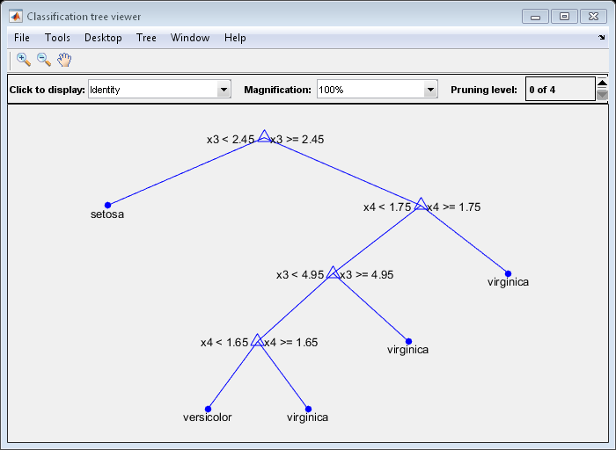
What is a decisions tree?
A set of ordered rules for classifying data
Each node addresses an input variable
Leaves assign labels to the data

Slide 3
Types of Decision Trees
Classification trees have leaves with discrete classes
Regression trees have leaves with numerical values

Slide 4
Advantages of Decision Trees
Simple and intuitive
Unlike artificial neural networks
Good computational performance
Robust
Possible to validate a model using statistical tests (next week)

Slide 5
Limitations of Decision Trees
Greedy algorithms can get stuck in local optimality
The simple decision structure does not represent all problems effectively
XOR, parity
Produce large trees
Can produce overly complex trees that do not generalise well
overfitting

Slide 6
Decision Tree Learning Algorithms
Information gain
ID3
C4.5
Gini Impurity and Variance Reduction
CART
MARS
CHAID
Conditional Inference Trees

Slide 7
How are decision trees constructed
The data set is split recursively into sub-sets based in a single input variable
Until
All sub-set has same class
Splitting no longer improves prediction
Sub-sets are too small
Top-down induction of decision trees (TDIDT)
Greedy

Slide 8
Decision Tree Learning Algorithm
T = empty tree
repeat
split data-set, D, into sub-sets, S₀-S_{n}, using T
for each subset, S_{i}
for each variables, x_{j}
for each values, v_{k}, in S_{i}
split S_{i} into sub-sets S_{i1} and S_{i2}: v_{k}>x_{j} and x_{j}>=v_{k}
find max improvement max(I(S_{i1}, S_{i2})) for split <S_{i}, x_{j}, v_{k}>
add split <S_{i}, x_{j}, v_{k}> with max(I(S_{i1}, S_{i2})) to T
until max(I(S_{i1}, S_{i2})) <= 0.0

Slide 9
How are the sets split?
Identify Candidate splits
Apply metric to the resulting sub-sets
Choose the split that produces the best sub-sets

Slide 10
Identifying Candidate Splits
Each decision tree node descries
A rule for dividing a data set
All rules have the same form, consisting of
A variable to be considered
A threshold value to compare data points to
Threshold values between the values found in the data set
Do not improve classification within the given data set
What about classification of new data points?

Slide 11
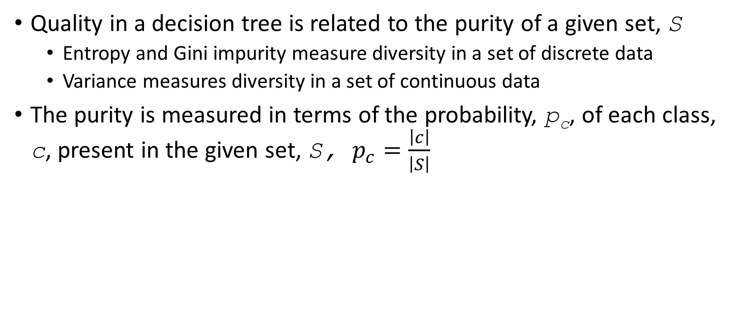
Split Quality - Purity Metrics
Quality in a decision tree is related to the purity of a given set, S
Entropy and Gini impurity measure diversity in a set of discrete data
Variance measures diversity in a set of continuous data
The purity is measured in terms of the probability, p_{c}, of each class, c, present in the given set, S, $p_{c}=\frac{\left|c\right|}{\left|S\right|}$

Slide 12
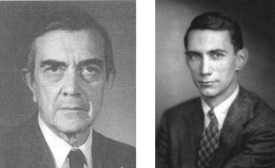
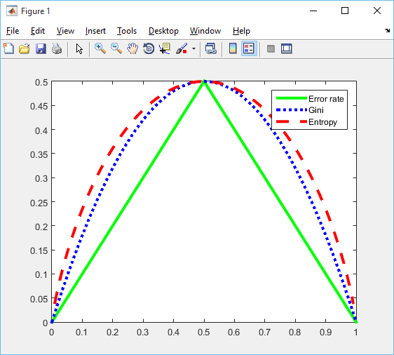

Metric Behaviour
Gini impurity
$Gini\left(S\right)=1−\sum_{c=1}^{l}{p_{c}^{2}}$
(Shannon) Entropy
$Entropy\left(S\right)=−\sum{p_{c}\log_{2}{p_{c}}}$
Error rate (majority class)
fraction of misclassified data points
plot code from pmtk3

Slide 13
Variance Reduction
For regression trees
Data points do not have a discrete class but a continuous value
Calculate the variance of the node before the split
Compare with the sum of the variances in the new nodes

Slide 14
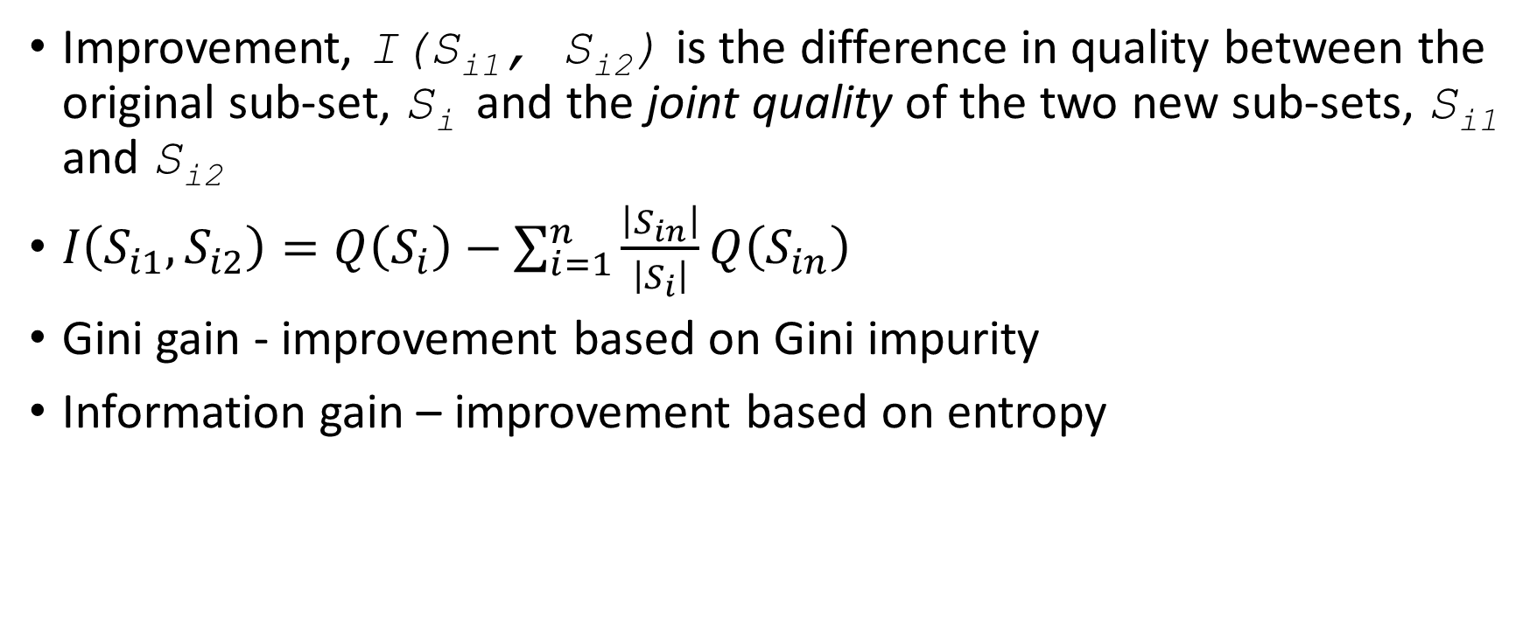
Improvement
Improvement, I(S_{i1}, S_{i2}) is the difference in quality between the original sub-set, S_{i} and the joint quality of the two new sub-sets, S_{i1} and S_{i2}
$I\left(S_{i1},S_{i2}\right)=Q\left(S_{i}\right)−\sum_{i=1}^{n}{\frac{\left|S_{in}\right|}{\left|S_{i}\right|}Q\left(S_{in}\right)}$
Gini gain - improvement based on Gini impurity
Information gain – improvement based on entropy

Slide 15
Your Task
Load a data set and augment with set index and, max gain
A function for calculating the entropy of a data set
entropy(S)
A function for splitting a data set given a rule
[S1,S2] = split(S, varIdx, threshold)
A function for calculating the information gain of a split set
gain(S,S1,S2)
A function for generating rules
[varIdxs, thresholds] = candidates(S)
A function for splitting sub-sets until all gains are 0 or negative

Slide 16

Fisher’s Iris Data Set
From the UCI ML repository
Measurements of plant parts
Four real valued attribues
sepal length in cm, sepal width, petal length, petal width
Classified into three types of iris plants
setosa, versicolor and virginica

Slide 17

MATLAB Classification Tree Functions
Load your dataset
load ionosphere
Create the classification tree
Check what the input variables and target classes are called
ctree = fitctree(X,Y);
View the classification tree
view(ctree,'mode','graph');
Create some test data
testX = (rand(1,4)*2)-1
Classify the test data
testClass = predict(ctree,testX);

Slide 18
Evaluating a Decision Tree
Error rate
The proportion of errors across all instances
Resubstitution error
Error rate on the training data
Tends to be optimistic due to overfitting
Test set error
The performance on a previously unseen set of test data.
Holdout
Reserving some data, often 20%, for testing
N-fold cross-validation

